Slide 1
Case Study 3 Insurance Premium

Slide 2
Case Study – Insurance Premium
Problem Statement
In 2022, Singapore's life expectancy is around 83 years old. Obesity has been rising in recent years, leading to a higher risk of health problems and shortened life expectancy
Ideally, a beneficiary claim should not exceed the customer premium claim. In reality, due to obesity, obese policyholder’s claims had exceeded their premium
Obese policyholders have higher needs and demands for medical care
More claims lead to lesser profit
Notes:
Problem Statement
Ideal – Describe a desired goal or ideal situation
Reality – Describe a condition that prevents the goal, state or value in Part A from being achieved or realized at this time; explains how the current situation falls short of the goal or ideal
Consequences – Identifies the way you propose to improve the current situation and move it closer to the goal or ideal

Slide 3
Data
Data is taken from https://www.kaggle.com/datasets/simranjain17/insurance (insurance.csv)
Age from 18 to 64 years old
BMI from 15.96 to 53.13
Premium charges from $1.12k to $63.8k
There is a total of 1,338 policyholders

Slide 4

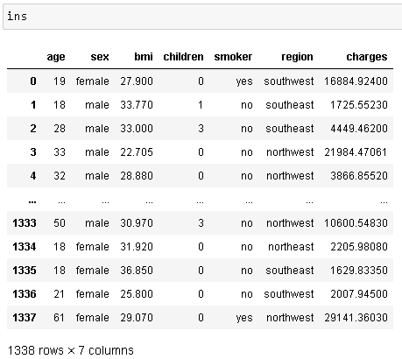
Data
Steps taken to collect and consolidate the data
This is how the data appears before any cleaning

Slide 5
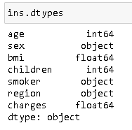
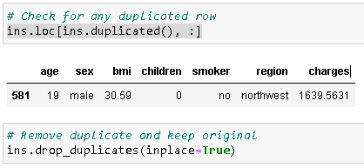
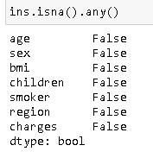

Exploratory Data Analysis (1/2)
Check for duplicated rows and remove if any
Check for correct data type and any missing values
Check for any negatives values
Rename charges column to premium_charges

Slide 6
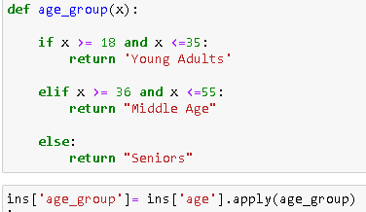
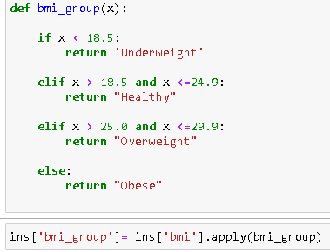
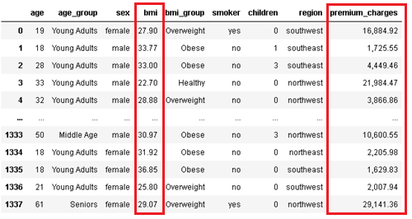


Exploratory Data Analysis (1/2)
age_group and bmi_group was created from bmi and age columns
bmi and premium_charges was converted to 2 decimal place
After data is cleaned, saved to insurance_cleansed.xlsx format

Slide 7
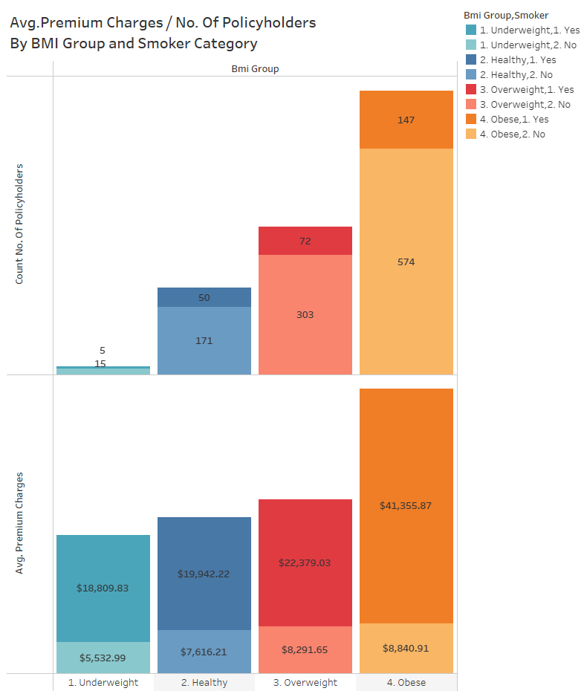
Exploratory Data Analysis (2/2)
Average Premium Charges / No. Of Policyholders
plotted against BMI Group and Smoker Category
There is a total of 721 obese policyholders
As BMI increases, charges increases as well
147 Obese Smokers
574 Obese Non-smokers

Slide 8
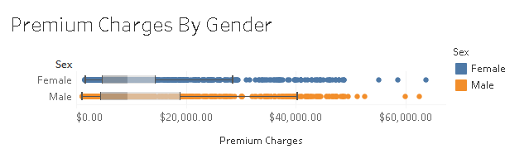
Exploratory Data Analysis (2/2)
Premium Charges plotted against Gender
Males are charged more (as compared to Females)

Slide 9
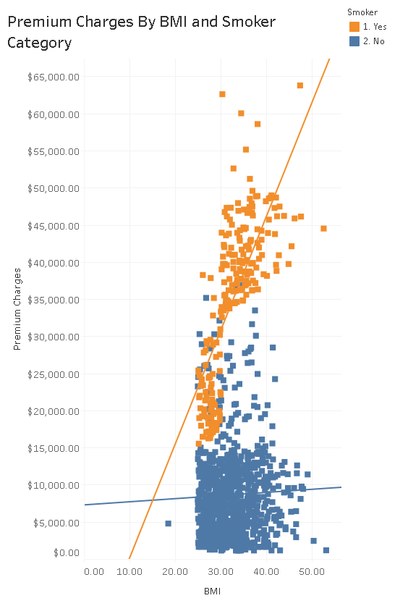
Exploratory Data Analysis (2/2)
Premium Charges plotted against BMI and
Smoker category
Charges increases with BMI
Smokers are charged more (as compared to non-smokers)

Slide 10
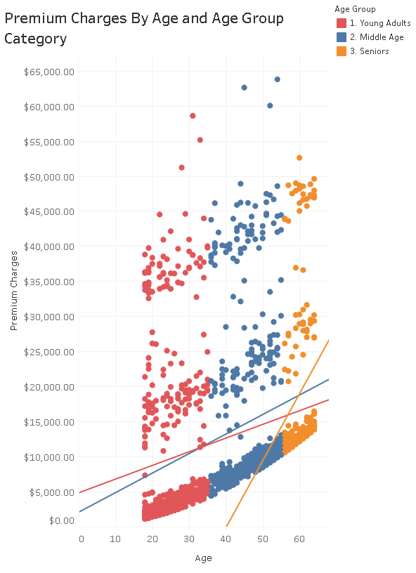
Exploratory Data Analysis (2/2)
Premium Charges plotted against Age
and Age Group
Charges increases with Age
Seniors are charged more (as compared to young adults and middle aged)

Slide 11
Dashboard
https://public.tableau.com/app/profile/kaijie.ng/viz/CaseStudyInsurance/InsurancePremiumsDashboard?publish=yes

Slide 12
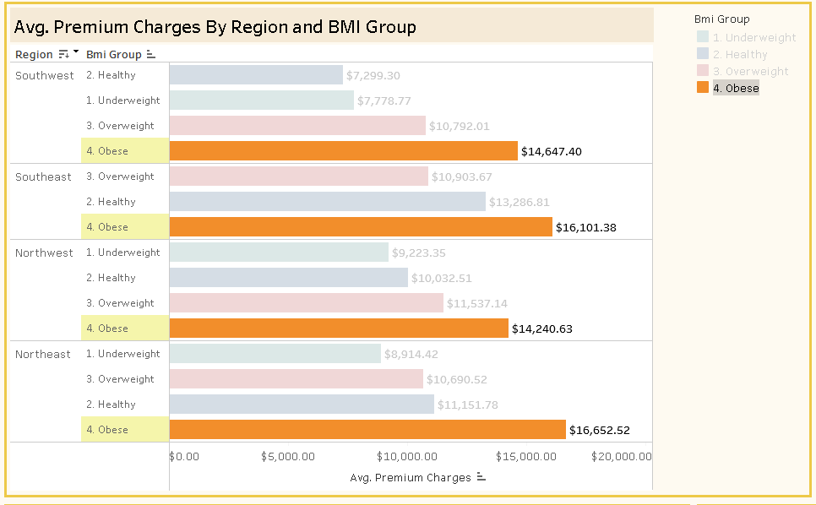
Strategy: Key Recommendations
Who are the main customers?
Obese policyholders paid the highest Average Premium Charges across all different regions
We will further analyse on the 3 different types of Age Group (Young Adults, Middle Age & Seniors)

Slide 13
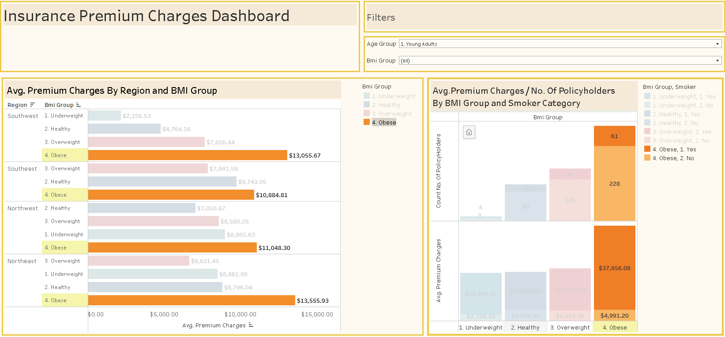
Strategy: Key Recommendations
Young Adults
61 Obese Smoker
228 Obese Non-smokers
Obese policyholders paid the highest Average Premium Charges across all different regions
There is a total of 61 obese smokers and 228 obese non-smokers policyholders in Young Adults group

Slide 14
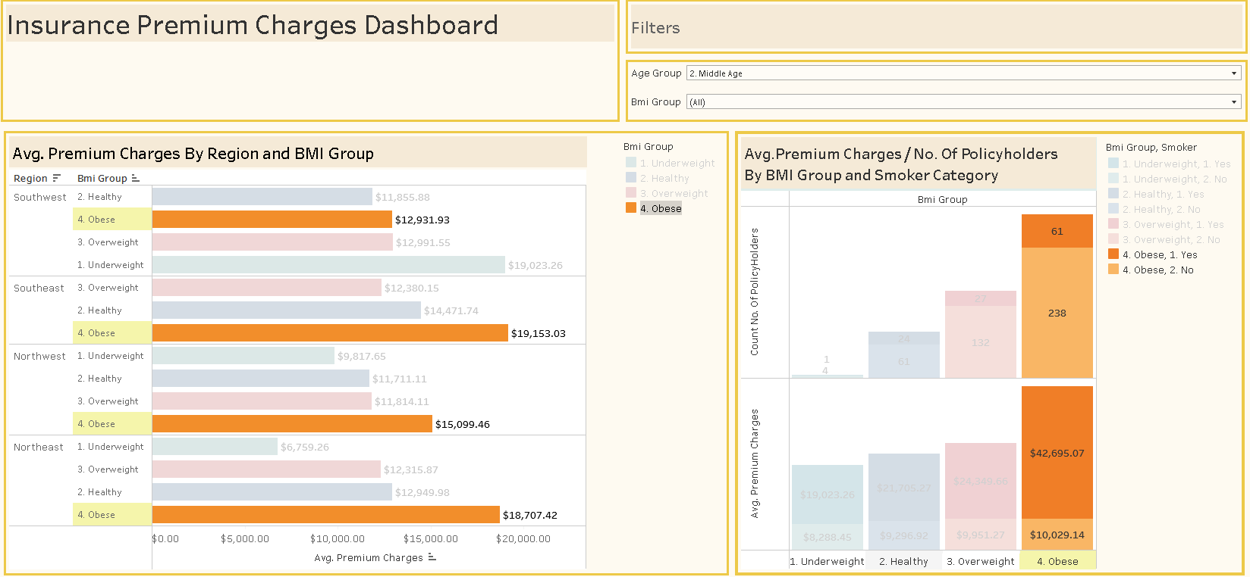
Strategy: Key Recommendations
Middle Age
61 Obese Smoker
238 Obese Non-smokers
Total 5 Underweight in Southwest
1 Underweight smoker
4 Underweight non-smokers
Obese policyholders paid the highest Average Premium Charges across all different regions except Southwest Underweight policyholders
There is only a total of 5 underweight policyholders in Middle Age group
There is a total of 61 obese smokers and 238 non-smokers policyholders in Middle Age group

Slide 15
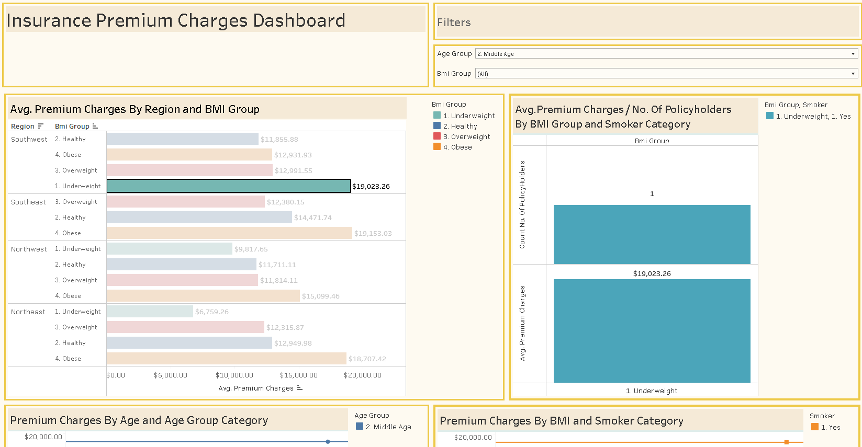
Strategy: Key Recommendations
Middle Age
Why Middle Age group in Southwest Underweight group paid the highest Average Premium Charges ?
There is only 1 policyholder in Middle Age group in Southwest that is underweight
Policyholder is a smoker therefore charged at a higher premium

Slide 16
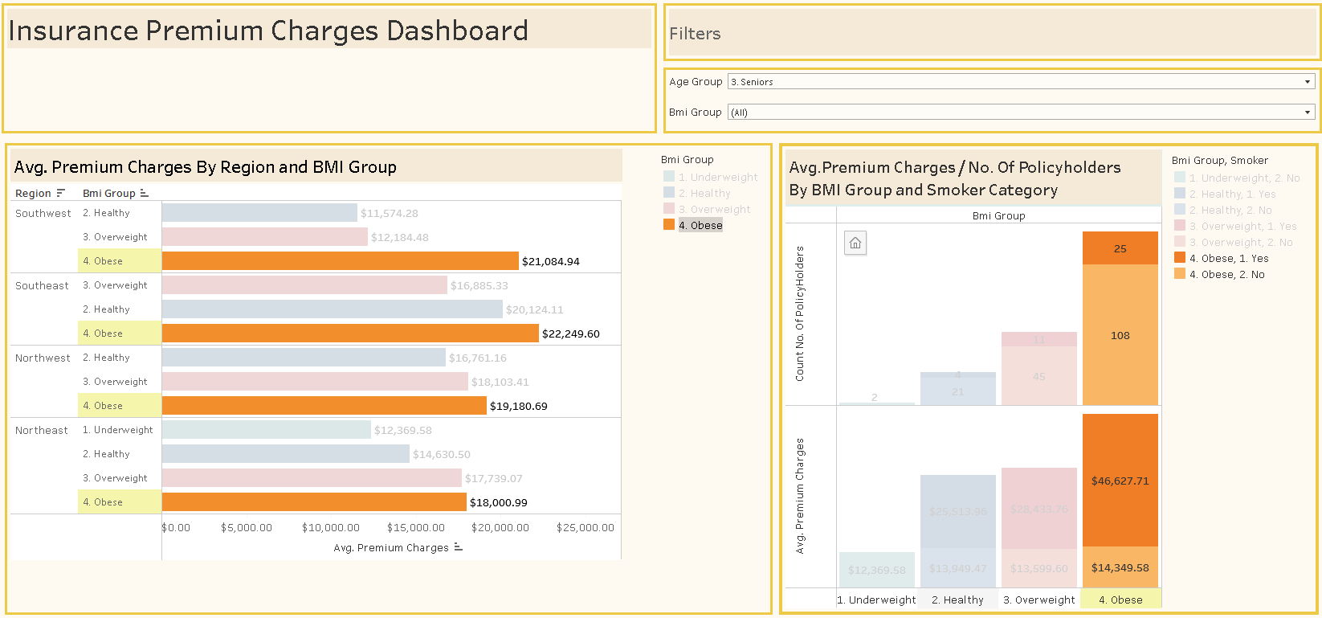
Strategy: Key Recommendations
Seniors
25 Obese Smoker
108 Obese Non-smokers
Obese policyholders paid the highest Average Premium Charges across all different regions
There is a total of 25 obese smokers and 108 non-smokers policyholders in Seniors group

Slide 17
Strategy: Key Recommendations
To reduce obese people from claiming, the company can help them to lose weight while maintaining customer retention rate at the same time
The recommendation is to collaborate with government to help promote health awareness
Study customer's lifestyle habits, and reward them with food/entertainment vouchers if they hit a certain quota of exercising

Slide 18
Strategy: Key Recommendations
To attract new customers, the company can implement a new Insurance Enhance Benefit Package (IEBP), mainly targeting obese people
Rate of return (ROR) for normal BMI 5%
IEBP ROR 3% only, but if their weight hits optimal weight, the package will auto-enhance to 7% for a certain period

Slide 19
Conclusion
Data analysis has identified obese policyholders paid the highest across all different regions as main customers, but there could be changes with more data in the future
To reduce more claims from the obese group, the company can collaborate with government to help promote health awareness
Study customers’ lifestyle habits and reward them with food/entertainment vouchers if they hit a certain exercise quota. This helps in customer retention
To attract new customers, the company can implement a new Insurance Enhance Benefit Package targeting obese customers
However, competitors might also implement IEBP at an even lower price. The company has to consider these to determine profit or loss
Surveys needed for customers' preferred vouchers and government health agency collaboration

Slide 20
Conclusion
What have you learnt?
I have learnt new technical skills like python, tableau and sql
Identify different sources of data and basic data quality standards
Apply the right visualisation for different types of charts
What were the main challenges in applying data analytics skills to this project?
To identify and research problem statement and recommendations
Limited data columns from excel

Slide 21
THANK YOU

